Slide 1
Credit Risk Profile and Mitigation Strategies
An Analytical Approach

Slide 2




Executive Summary
Q3 Default Rates on unsecured lending - Significant increase
Demand Increase (Q3)
Unsecured lending products
Credit card lending
Mitigation Strategy:
Tighten lending criteria
Risk Profile Analysis
Source: http://www.ftseglobalmarkets.com/news/uk-lenders-tighten-up-on-credit-criteria-though-business-default-rate-stable-says-boe-report.html

Slide 3
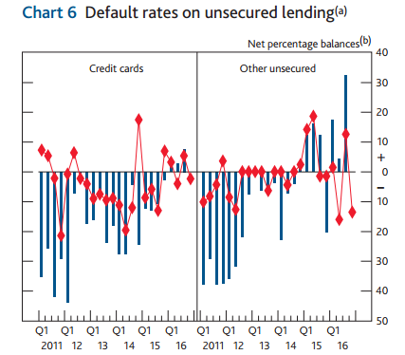

Introduction
Why this problem matters
This is already happening in real life
How would analytics help
Different decisions are made in credit management
Approve/Reject?
Price?
Amount/Limit?
Term?
Etc.
Decisionmakers
Source: http://www.bankofengland.co.uk/publications/Documents/other/monetary/ccs/2016/16q3.pdf

Slide 4
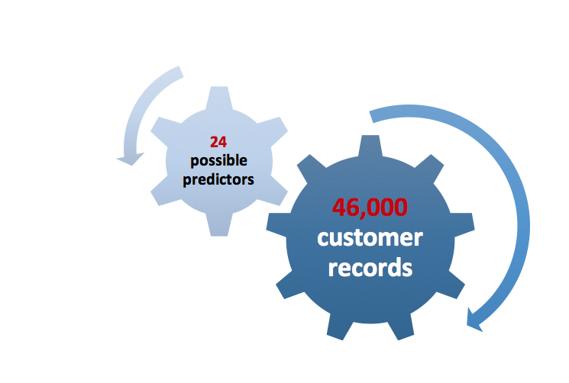
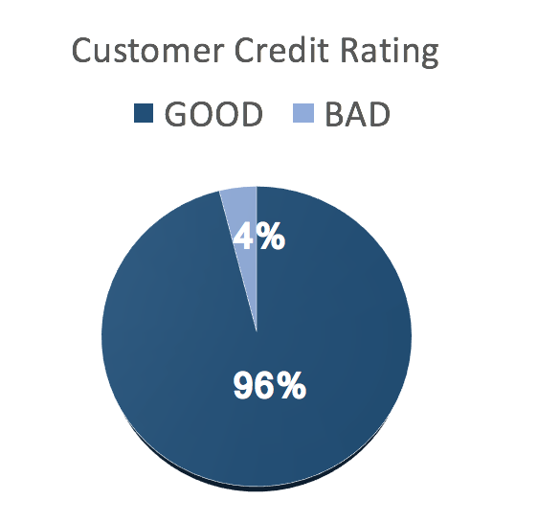
Summary of Data
Data set info
Data issues
Imbalanced data
Missing values
Variable Misclassification

Slide 5
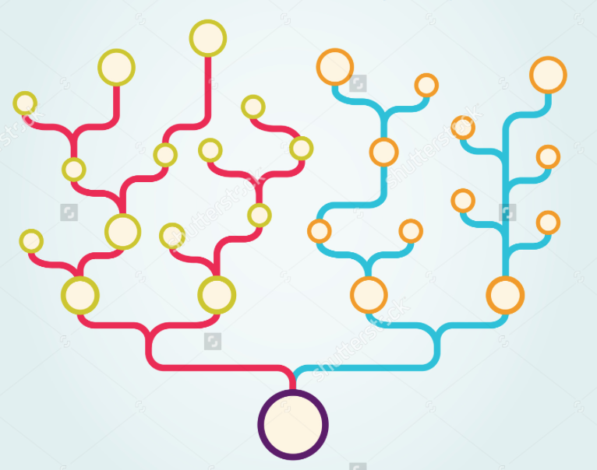
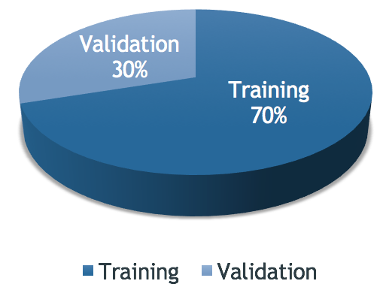
Model Building
Decision Tree
Training and validation

Slide 6
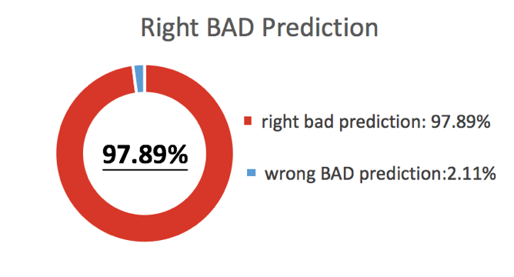

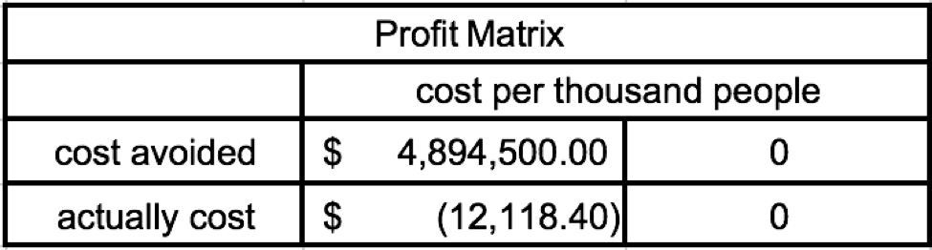
Model Performance
According to the confusion matrix, our Decision Tree Model does a excellent job in predicting BAD risk !!
Notes:
Since the purpose of our model is to tell bad customers from good ones, we set the cut-off value as 0.1, that is to say, when 1 represents customers with bad risk, and 0 represents customers with good risk, our cut-off value is the boundary of bad and good.
In this case, we have a 97.89% rate of correctly distinguish bad risk customers. Our model does a very good job in predicting bad risk!
Let take a look at how this model perform in real life situations. Assume we are a 7 people group, the salary for each member is $100000(one hundred thousands), the money we have to spend on each admitted customer is $5000, and the number of our customer data set is 500000(five hundred thousands), by using this model, we could avoid $4894500.00(five thousand) unnecessary cost, and will cut down our actual cost to $12118, that’s a huge improvement.
So what kind of variables will contribute to a customer’s risk status, Yi will explain that to us.

Slide 7
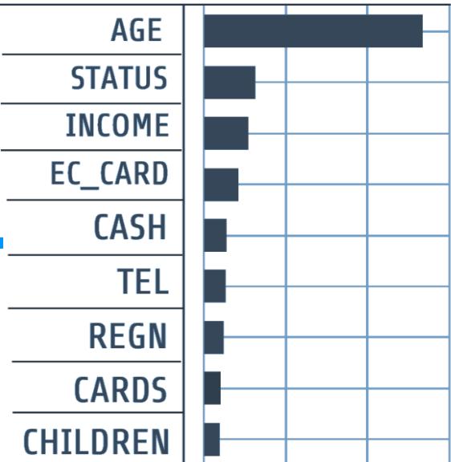
Results Summary
Leaf report
Presents variables in groups;
Shows a much richer concentration;
3 Groups can predict more than 90% of Bad Risk.
Concerns
Uncertainty of the optimal solution during the random resampling process
Notes:
From the decision tree model column contributions, according to the G^2 score we know that the top 5 influential variables are AGE, STATUS, INCOME, EC_CARD and CASH. Those 5 variables together can explain 76.4% of the whole decision tree model. To better understand and interpret the influence of those variables, we can also take a look at the leaf report,that have much richer concentrations of our target variable, Bad Risk. For example, the group that predicts the highest percentage of Bad Risk are People between age under 28, having less than 2 phone, no children and no ec-card with the company, and this group and predict up to 97.78% of BAD RISK.
Overall, our model did a g ood job in predicting our target variable-Bad Risk, according to the confusion matrix and profit matrix xinyi mentioned before and our model can predict Bad Risk better than a random sorting model. However, there are still a few concerns relating to our model, as we went through a random sampling of RISK, so everytime the model runs it results in different spilt with decision tree, creating uncertainty on the optimal solutions.

Slide 8
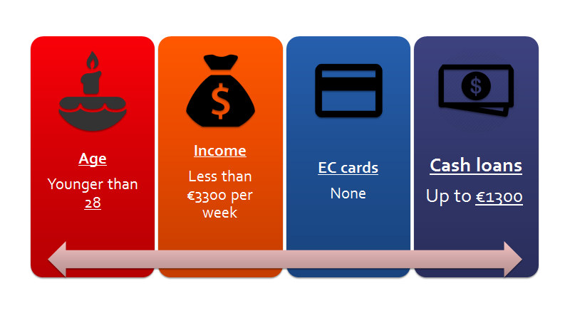
Risk Profile
Strategies:
More cautious check of potential and existing customers
Segmenting the customers
Stricter screening of those fitting the profile
Improve models by incorporating new methods
Notes:
https://infograph.venngage.com/publish/751c3ba2-04e9-487d-9c56-b9506dbb9280

Slide 9

THANK YOU FOR LISTENING!
We hope you enjoyed our presentation.
Do you have any questions?

Slide 10
Q & A
Appendix:
1. ADD-INs
2. ROC Curve
3. Alternate Cut-off Confusion Matrix
4. Leaf Report

Slide 11
Appendix 1: ADD-IN
Random seeds 123
This will ensure we get the same results when we launch the partition platform (decision tree) and perform the modeling analysis
Alternate cut-off confusion matrix
Designed to allow the user to specify a cut-off value or a range of values to generate a new confusion matrix for a binary response variable.
Stratified Split Balanced
This add-in can be used for oversampling when the target variable class of interest is underrepresented or rare. The add-in allows you to:
Partition data into training, validation, and test sets, stratified according to a target variable
Balance the training (or training and validation) set to have equal numbers of the focal and non-focal groups

Slide 12
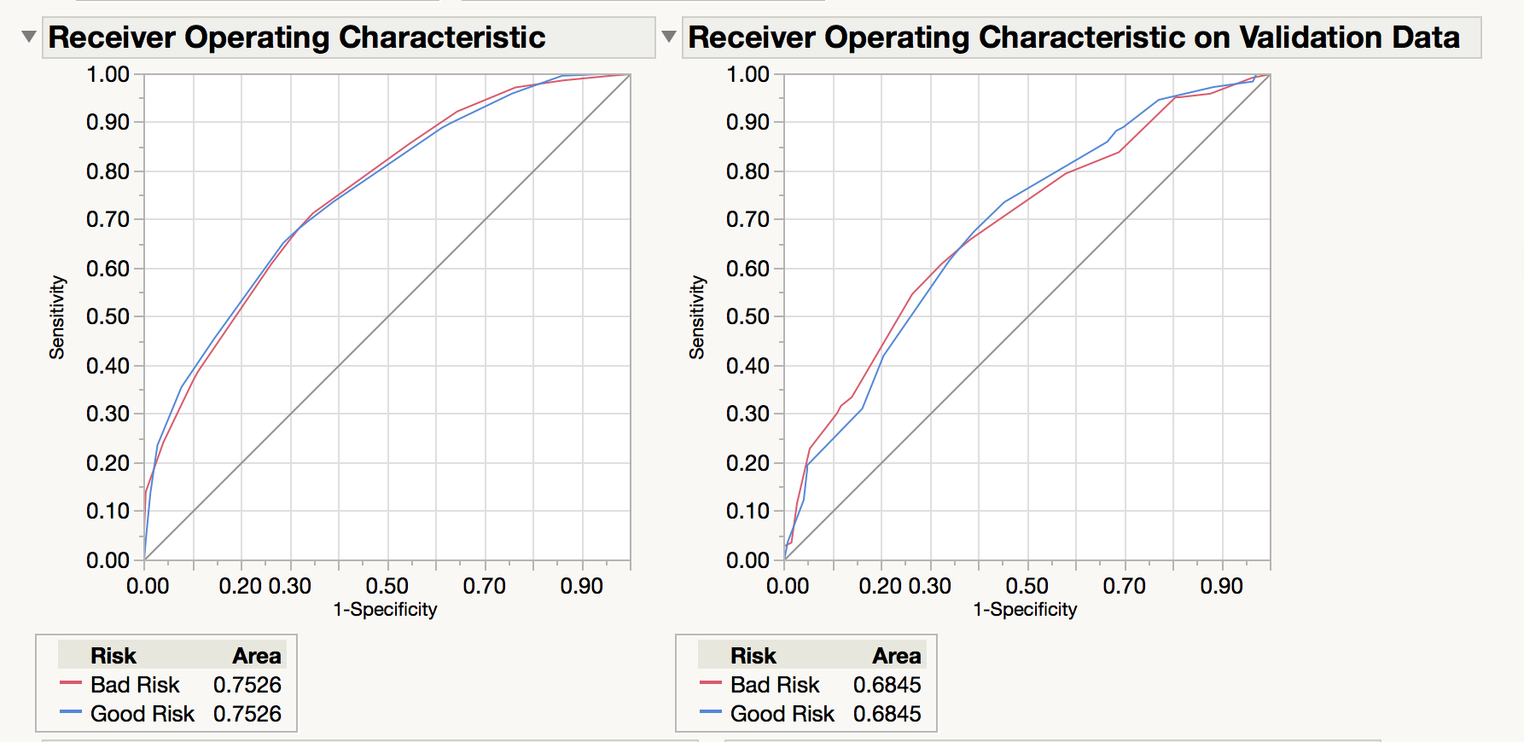
Appendix 2: ROC Curve

Slide 13
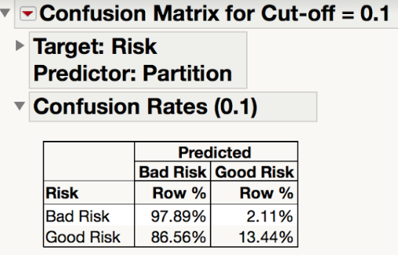
Appendix 3: Alternate Cut-off Confusion Matrix

Slide 14
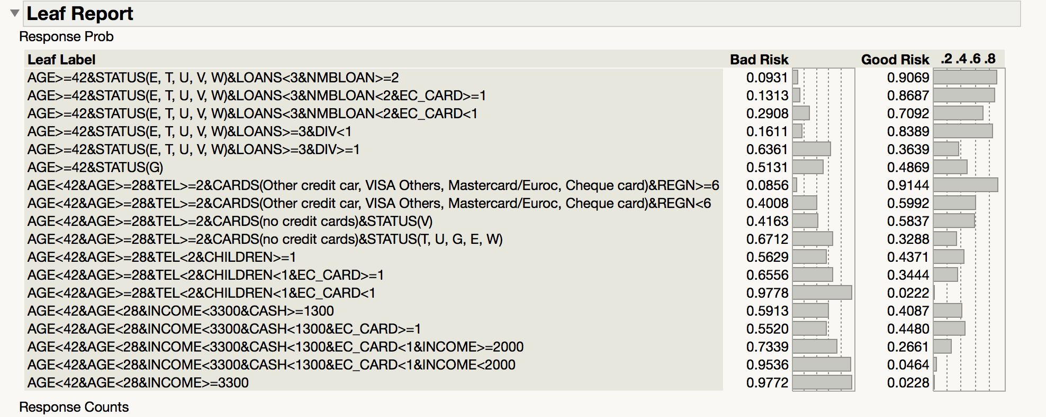
Appendix 4: Leaf Report

